Slide 1
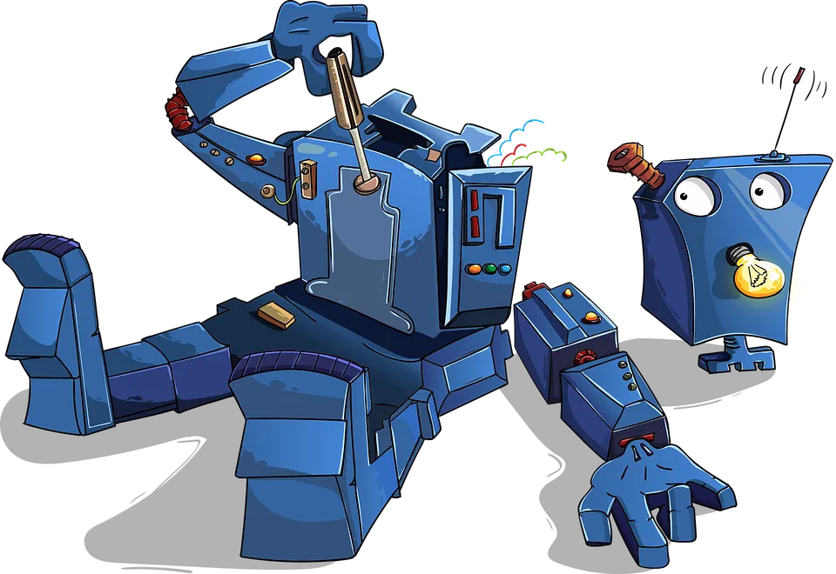
Toolformers
https://miro.medium.com/v2/resize:fit:4800/format:webp/1*2DjQyJMJRHofI2I_Nd7BMQ.png

Slide 2
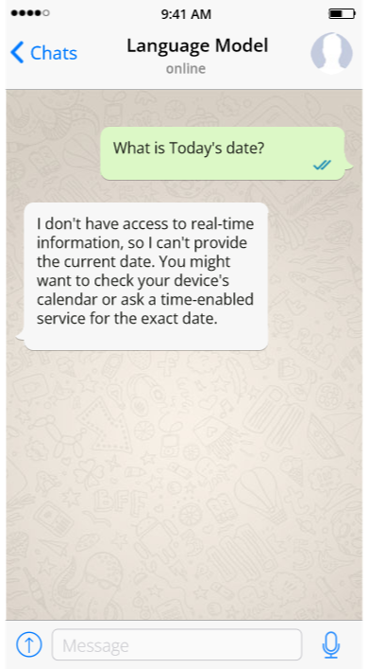
What can LLMs NOT do?
Emotions and Intentions
Verification of Facts
Ethical and Moral Judgments
Access Real-time or Up-to-date Information
Executing Tasks Requiring Physical Actions or Sensory Input

Slide 3
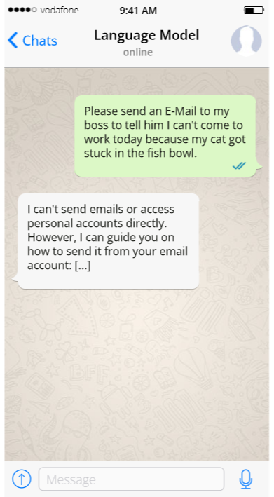
What can LLMs NOT do?
Emotions and Intentions
Verification of Facts
Ethical and Moral Judgments
Access Real-time or Up-to-date Information
Executing Tasks Requiring Physical Actions or Sensory Input

Slide 4
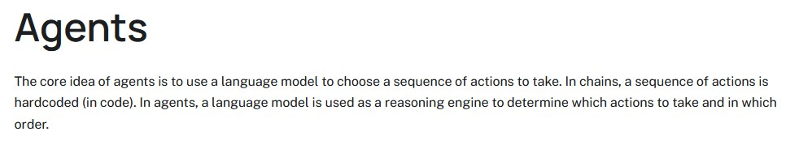
Agent
https://python.langchain.com/v0.1/docs/modules/agents/

Slide 5
Agent
https://python.langchain.com/v0.1/docs/modules/agents/

Slide 6
Agent
LLMs don‘t perform the action themselves, they only trigger an external service to do it
https://python.langchain.com/v0.1/docs/modules/agents/
What is a „Trigger“? -> The name of the tool that the agent chose to execute

Slide 7
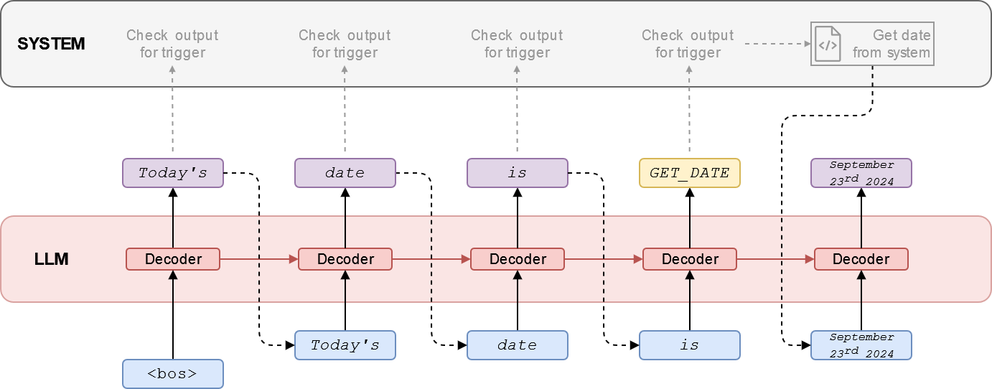
Agent
LLMs don‘t perform the action themselves, they only trigger an external service to do it.
What is today‘s date?

Slide 8
Agent
LLMs don‘t perform the action themselves, they only trigger an external service to do it.
What is today‘s date?

Slide 9
Agent
LLMs don‘t perform the action themselves, they only trigger an external service to do it.
What is today‘s date?

Slide 10
Agent
LLMs don‘t perform the action themselves, they only trigger an external service to do it.
What is today‘s date?

Slide 11
Agent
LLMs don‘t perform the action themselves, they only trigger an external service to do it.
What is today‘s date?

Slide 12
Agent
LLMs don‘t perform the action themselves, they only trigger an external service to do it.
! Implemented Manually !
What is today‘s date?

Slide 13
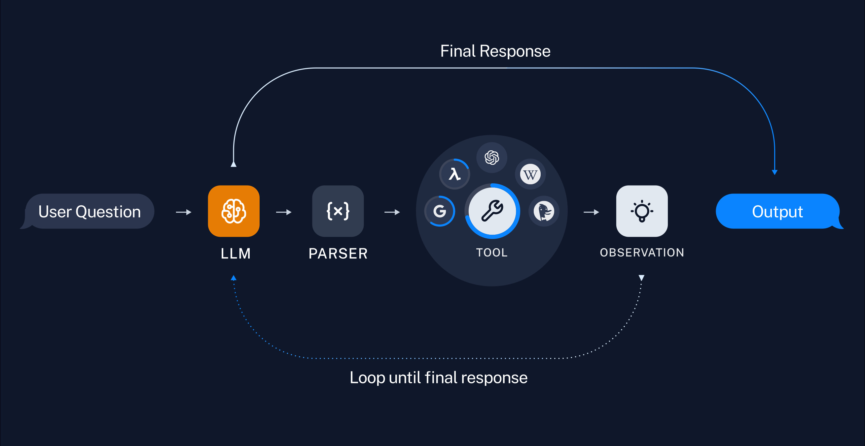
Agent
LLMs don‘t perform the action themselves, they only trigger an external service to do it.
https://python.langchain.com/v0.1/docs/use_cases/tool_use/

Slide 14
Agent
LLMs don‘t perform the action themselves, they only trigger an external service to do it.
https://python.langchain.com/v0.1/docs/use_cases/tool_use/

Slide 15
It‘s not that difficult to implement! ☺

Slide 16
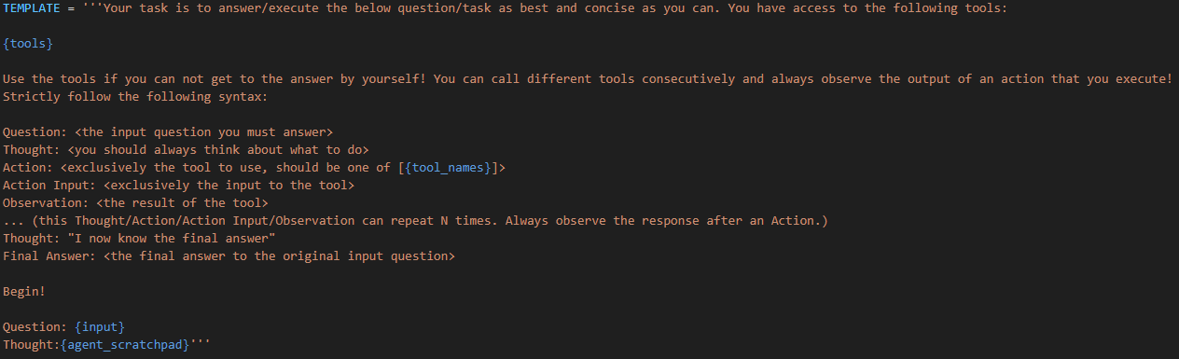
Agent - Prompting

Slide 17
Agent - Prompting

Slide 18
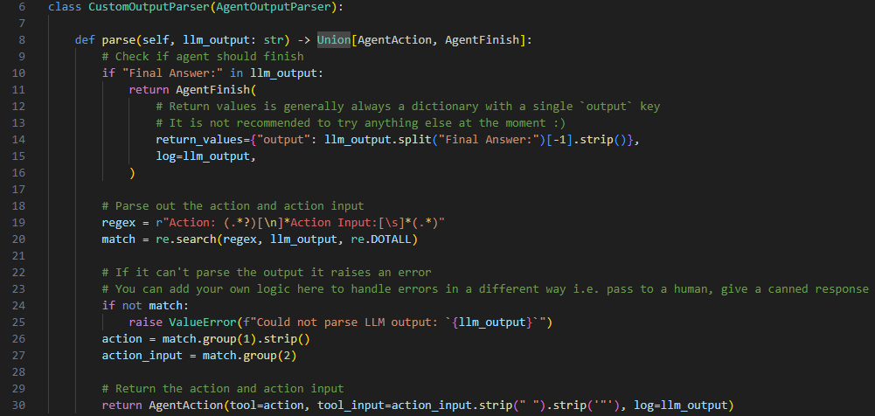
Agent - Parsing

Slide 19

Agent – Tool (Example)

